Slide 1
Calculating Family Expenses Using ServiceNow

Slide 2
Team Id: NM2025TMID13341
Team Members: 4
Team Leader: Nivetha.R
Team Member 1: Priyadharshini.S
Team Member 2 : Sharmila.K
Team Member 3 : Sneha.D

Slide 3
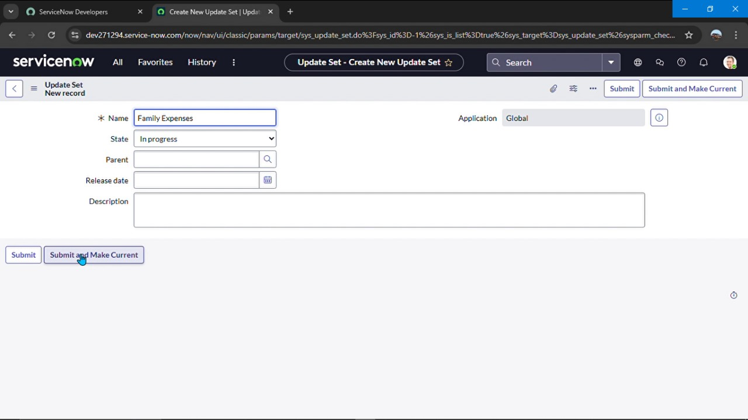
Creation Of New Update Set
1 . Go to all > filter search for Local Update set .
2 . Click new
3 . Enter detail name : Family Expenses
4 . Submit and make current

Slide 4
Creation Of Table
Creation of new update set
1.Go to all > search for Local update set
2. Click new
3. Detail = name - family expenses
4.Submit and make current

Slide 5
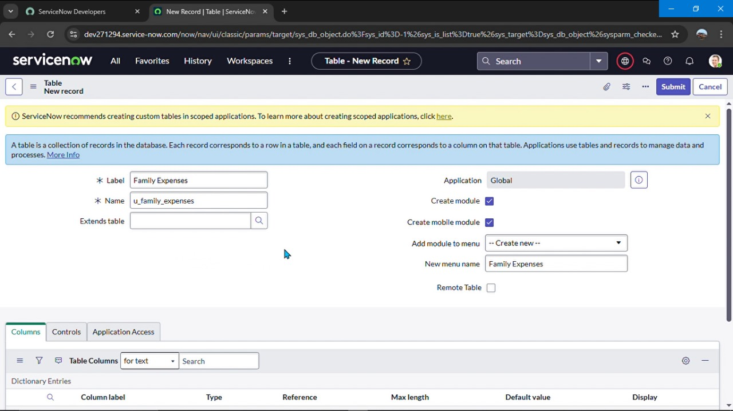
Creation Table
Creation of family expense table
1. Go to All > In the filter search for Tables > click on New.
Enter the Details:
Label : Family Expenses
Name : Auto-Populated
New menu name : Family Expenditure
2. Go header right click there > click save

Slide 6
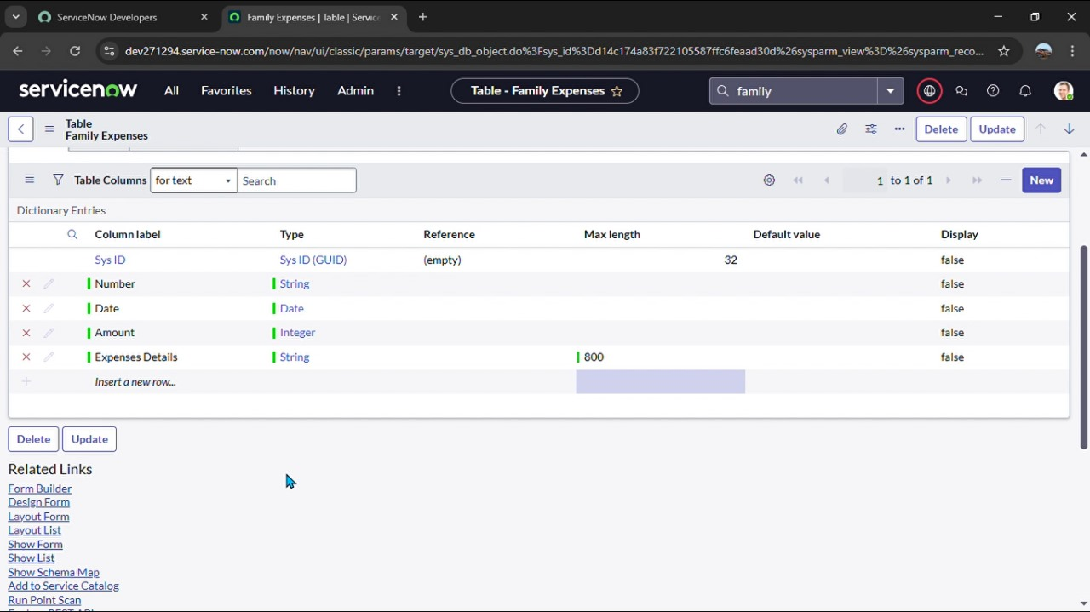
Creation of Columns(Fields)
Column label : Number
Type : String
Double click on insert a new row again
Give the details as:
Column label : Date
Type : Date
Double click on insert a new row again
Give the details as:
Column label : Amount
Type : Integer
Double click on insert a new row again
Give the details as:
Column label : Expense Details
Type : String
Max length : 800

Slide 7
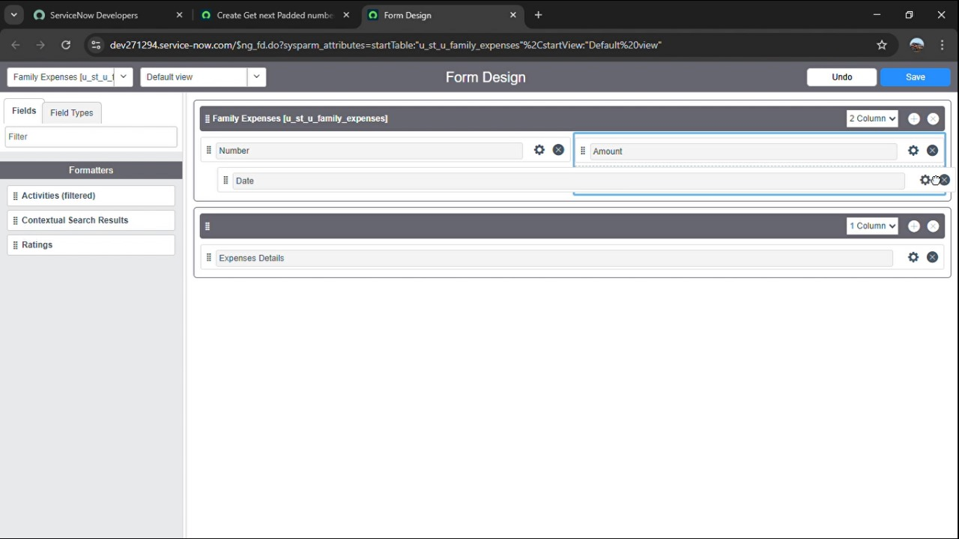
Configure the Form
1.Go all > search family expenses
2.Click new
3.Header configure select form design
4.Make date , amount, mandatory
5.Click save

Slide 8
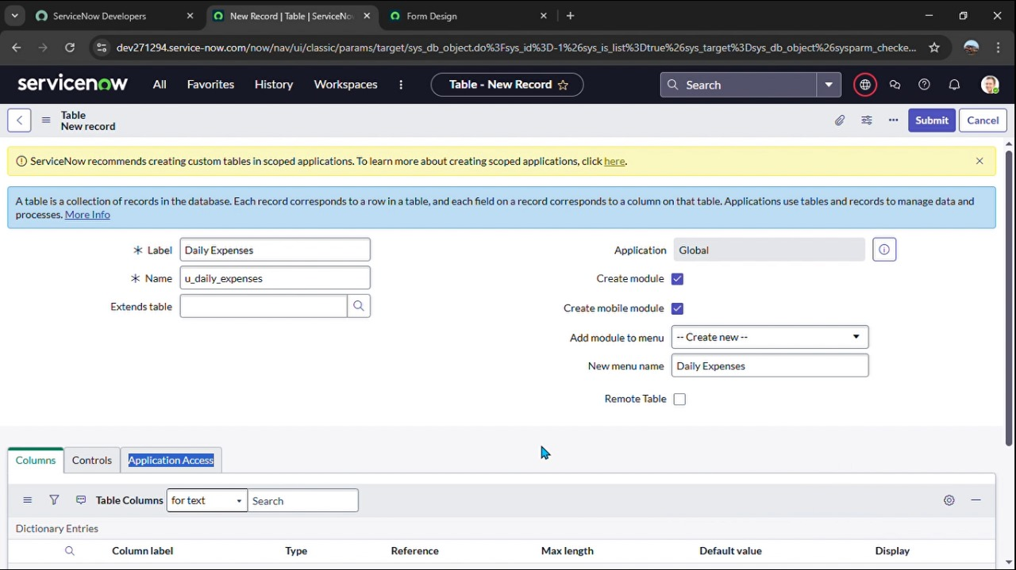
Creation of Daily Expenses Table
-> Go all > search tables
-> Details : daily expenses
-> Name : auto populated
-> Click right there and save

Slide 9
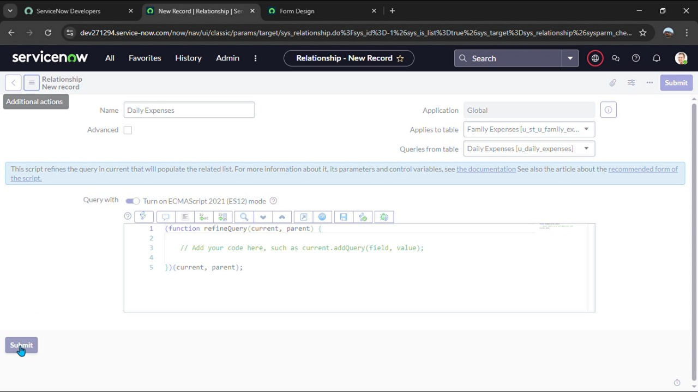
Creation of Business Rules
-> Go all > search Business rules
-> Detail name : family expenses BR
-> Table : daily expenses
-> When to run check insert and update
-> Then type code
-> Go to header and right click there >> click on save..

Slide 10
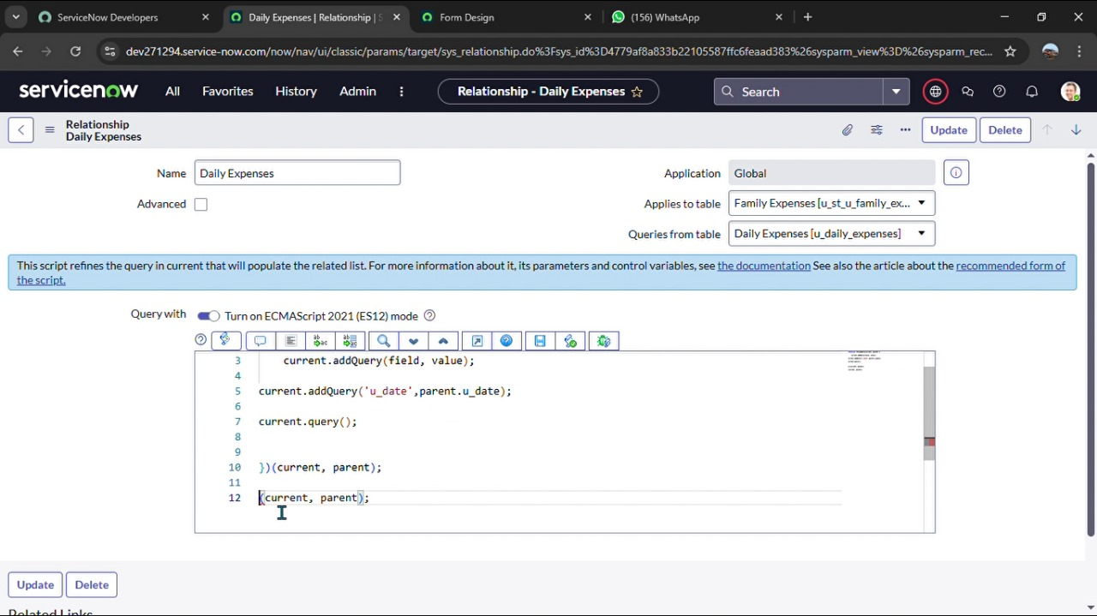
Configure the Relationship
-> Go all >> search relationship
-> Open daily expenses
-> Applies select family expenses
-> Then type a code
-> Click on update

